Slide 1
Supervision 101 building your foundation as a Kenyon supervisor
Kenyon college fall 2019

Slide 2
What is supervision?
Merriam-Webster says:
To be in charge of:

Slide 3
What is supervision?
Merriam-Webster says:
To be in charge of:
To oversee:

Slide 4
What is supervision?
Kenyon says:
Evaluate

Slide 5
What is supervision?
Kenyon says:
Evaluate
Manage

Slide 6
What is supervision?
Kenyon says:
Evaluate
Manage
Maintain

Slide 7
What is supervision?
Kenyon says:
Evaluate
Manage
Maintain
Coordinate

Slide 8
What is supervision?
Kenyon says:
Evaluate
Manage
Maintain
Coordinate
Plan

Slide 9
What is supervision?
Kenyon says:
Evaluate Schedule
Manage
Maintain
Coordinate
Plan

Slide 10
What is supervision?
Kenyon says:
Evaluate Schedule
Manage Train
Maintain
Coordinate
Plan

Slide 11
What is supervision?
Kenyon says:
Evaluate Schedule
Manage Train
Maintain Develop
Coordinate
Plan

Slide 12
What is supervision?
Kenyon says:
Evaluate Schedule
Manage Train
Maintain Develop
Coordinate Advise
Plan

Slide 13
What is supervision?
Kenyon says:
Evaluate Schedule
Manage Train
Maintain Develop
Coordinate Advise
Plan Lead

Slide 14
As a supervisor, I am responsible for …
Hiring

Slide 15
As a supervisor, I am responsible for …
Hiring
On-Boarding
Notes:
Her

Slide 16
As a supervisor, I am responsible for …
Hiring
On-Boarding
Time Keeping

Slide 17
As a supervisor, I am responsible for …
Hiring
On-Boarding
Time Keeping
Adhering to FLSA Standards

Slide 18
As a supervisor, I am responsible for …
Hiring
On-Boarding
Time Keeping
Adhering to FLSA Standards
Conflict Management

Slide 19
As a supervisor, I am responsible for …
Hiring
On-Boarding
Payroll
Adhering to FLSA Standards
Conflict Management
Resignations / Terminations / Retirement

Slide 20
As a supervisor, I am responsible for …
Hiring
On-Boarding
Time Keeping
Adhering to FLSA Standards
Conflict Management
Resignations / Terminations / Retirement
Reviews and Performance Guidelines

Slide 21
As a supervisor, I am responsible for …
Hiring
On-Boarding
Time Keeping
Adhering to FLSA Standards
Conflict Management
Resignations / Terminations / Retirement
Reviews and Performance Guidelines
Worker’s Compensation reporting, FMLA management

Slide 22
As a supervisor, I am responsible for …
Hiring
On-Boarding
Time Keeping
Adhering to FLSA Standards
Conflict Management
Resignations / Terminations / Retirement
Reviews and Performance Guidelines
Worker’s Compensation reporting, FMLA management
College Procedures

Slide 23
As a supervisor, I am responsible for …
Coordination of day-to-day activities for __________

Slide 24
As a supervisor, I am responsible for …
Coordination of day-to-day activities for __________
Managing the flow of communication and correspondence for ___________

Slide 25
As a supervisor, I am responsible for …
Coordination of day-to-day activities for __________
Managing the flow of communication and correspondence for ___________
Supporting the mission of the College, and ____________

Slide 26
As a supervisor, I am responsible for …
Coordination of day-to-day activities for __________
Managing the flow of communication and correspondence for ___________
Supporting the mission of the College, and ____________
Direct Manage Coordinate Evaluate Oversee Implement

Slide 27
challenges
What do you find challenging about your supervisory role?

Slide 28
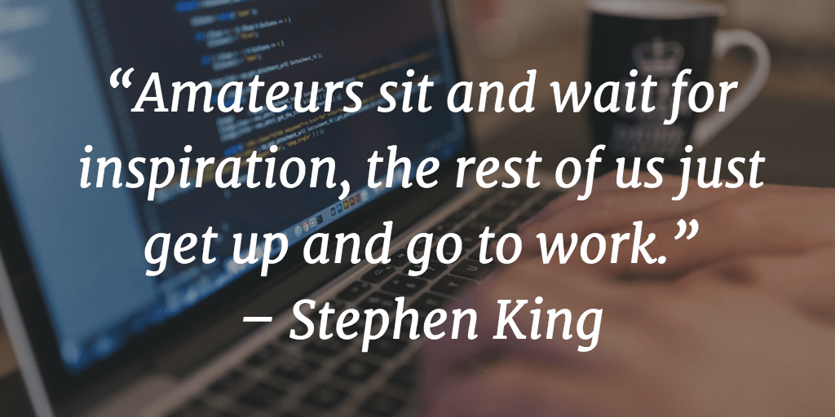
How can we be successful supervisors without the necessary tools?

Slide 29

BUILD YOUR TOOLKIT

Slide 30
BUILD YOUR TOOLKIT
Communication Connection

Slide 31
BUILD YOUR TOOLKIT
Communication Connection
Leadership Type

Slide 32
BUILD YOUR TOOLKIT
Communication Connection
Leadership Type
Checklists

Slide 33

Communication connection
Communication is one of, if not the most, important part of a supervisor’s role
Notes:
We are all busy. It can take as little as five seconds to respond to an email. With today’s technology you have access to your email 24/7 – does that mean you have to answer at midnight? Or 4am? No. But it means that you should be able to respond within 24 hours. And I’m not even talking about ANSWERING. I’m talking about responding, completing the connection of communication.

Slide 34

Communication connection
Hello, I need help
Notes:
I need help and call out to my supervisor.

Slide 35

Communication connection
I can help you!
Notes:
I need help. My supervisor responds to me and completed the connection.

Slide 36
Communication connection
Hello, I need help
Notes:
I need help and call out to my supervisor. They do not answer.

Slide 37

Communication connection
Hello, I continue to need help
Notes:
I call out again for help from my supervisor. They still do not answer.

Slide 38
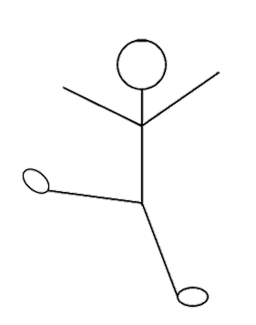
Communication connection
Hello, I STILL need help
Notes:
I’m now calling out for a third time for help from my supervisor.

Slide 39
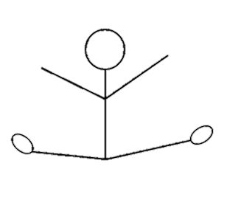
Communication connection
Help!
Notes:
My supervisor has not connected and has effectively prevented me from completing a task or responsibility.

Slide 40
COMMUNICATION CONNECTION
As a Kenyon Supervisor it is your responsibility to regularly communicate with your direct reports. For example …
Policy changes/updates
Important events
Benefit changes/updates

Slide 41
COMMUNICATION CONNECTION
Be Clear
Be Specific
Be Supportive
Work Together

Slide 42
BUILD YOUR TOOLKIT
Communication Connection
Leadership Type

Slide 43
What is your leadership style?
Supervisors must also be leaders. For this exercise, we will discuss two styles of leadership.
TASK RELATIONS
* Distribute Leadership Style Questionnaire

Slide 44
Task-Oriented
Plan short-term operations
Organize work activities to improve efficiency
Explain priorities for different task objectives
Assign work to groups or individuals
Clarify what results are expected for a task
Set specific goals and standards for task performance
Explain rules, policies, and standard operating procedures
Direct and coordinate work activities
Resolve Monitor Explain Organize

Slide 45
Relations-oriented
Provide support and encouragement to someone with a difficult task
Socialize with people to build relationships
Recognize contributions and accomplishments
Consult with people on decisions affecting them
Help resolve conflicts in a constructive way
Encourage mutual trust and cooperation among members of the work unit
Support Encourage Empower Socialize

Slide 46

discussion
Within your group, discuss your leadership style.
What are your strengths?
What are your weaknesses?
5 minutes

Slide 47
BUILD YOUR TOOLKIT
Communication Connection
Leadership Type
Checklists

Slide 48
Building your toolkit
Checklists
  Hiring Information
    Interview Guide
    Exempt & Non-Exempt Hiring Guidelines
    Creating a Posting
    Job Description Template
    Employment of Minors
https://www.kenyon.edu/directories/offices-services/human-resources/supervisors-toolkit/

Slide 49
Building your toolkit
Checklists
  Onboarding
    New Hire Orientation
    Webtime Entry
    Expectations, Performance Reviews, Employee Performance Program
https://docs.google.com/a/kenyon.edu/forms/d/e/1FAIpQLSfPjtY0M-ibqrrInUlhfMRl3QT6dqioMsPYQIyesFPpSah8-g/viewform?c=0&w=1

Slide 50
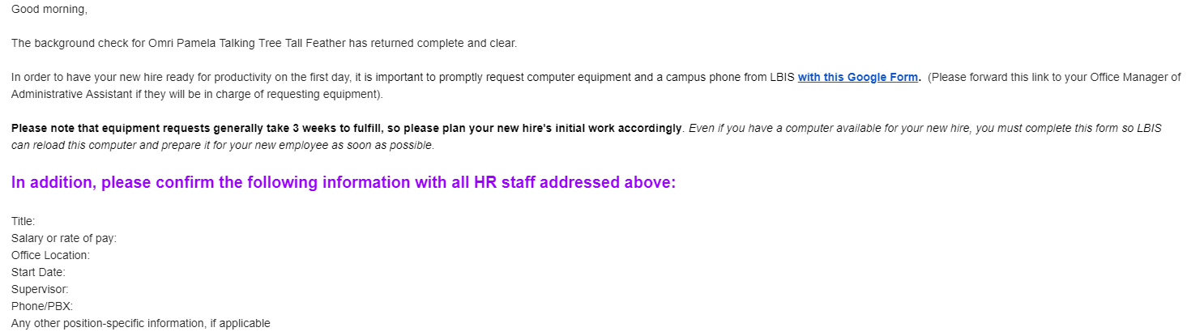
Supervisor information for a new hire
Notes:
This email goes out from Tony Cline after a new hire clears their background check. It is sent to the supervisor.

Slide 51
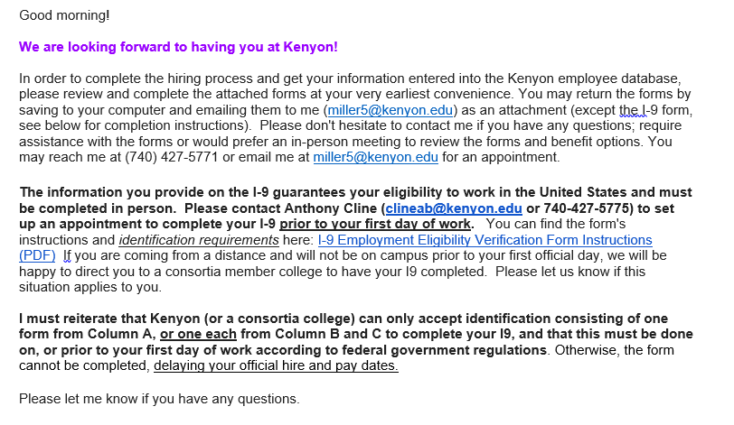
New hire information
Included with Email:
Benefits Enrollment Form
Tax Forms
I9
Direct Deposit Form
Notes:
The first email new hires receive from HR

Slide 52
Web time entry the importance of creating a proxy
Supervisors are responsible for webtime entry of each non-exempt employee in their department
Webtime hours must be entered by your staff member no later than 4:30pm the Monday after the pay period ends
Supervisors must approve timesheets no later than 4:30pm the Friday after the pay period ends
Supervisors must assign a proxy to approve time if they are out of the office. Please contact the payroll office to ensure that your proxy has the appropriate account access.
Notes:
Reminders only go to supervisors, your responsibility to inform your Proxy.

Slide 53

Employee performance program
Once a quarter Kenyon supervisors should be writing feedback in the employee performance folder for each of their direct reports
Notes:
Think right now, without raising your hands, if you have done your reviews? Have you done all of them? Why is this important? Some of you may say “ But I talk to my direct reports every week. I don’t always have time to write anything down, but I talk to them “ That’s not what is expected of a Kenyon supervisor.

Slide 54


Importance of employee performance reviews
Struggling Employee
Successful Employee
Document where improvement is needed
Show improvement/decline over a period of time
Document Strengths
Show potential for new roles, promotions, etc.
Notes:
Struggling employee – allows to see improvement, or allows to see lack of improvement and prepare for termination or reassignment.
Wonderful employee – allows to see continued and consistent great work, easy way to prove validity for raises or promotions

Slide 55
Disciplinary action policy three step procedure
Step One
Oral Reminder
Step Two
Written Reminder
Step Three
Decision-Making Leave
Discuss the Problem
Document Discussion
Not placed in personnel file
No improvement within 3 months
Discuss the Problem
Write a memo to the employee
Place in personnel file
No improvement within 3 months
Place on leave (1 day)
Supervisor writes a letter for employee to sign
If no improvement the next step is dismissal
Dismissal

Slide 56

Employee development
    Available Online training programs
https://www.kenyon.edu/directories/offices-services/human-resources/current-employees/development-opportunities/
Notes:
When you have an employee that needs development, a great place to start is the Kenyon website! There is an entire section on development opportunities. You can also find your own opportunities!

Slide 57
Development opportunities
Safe colleges
hoonuit
Active Shooter
Conducting Interviews
Avoiding Discrimination
Managing Difficult Behaviors
Performance Evaluations
Performance Management
Reasonable Suspicion
Sensitivity Awareness
Many, Many more!
Responsible Decision-Making
Improving Social Awareness
Developing Self-Management Skills
Developing Healthy Relationship Skills
Social Emotional Learning Essentials
Using Data to Improve Learning
Emotional Wellbeing and Stress Reduction
Many, many more!

Slide 58

Questions?
Notes:
Before we continue- are there any questions? Comments? Concerns?

Slide 59
Building your toolkit
Checklists
  Off-Boarding
    Termination
    Resignation
    Retirement
https://docs.google.com/a/kenyon.edu/forms/d/e/1FAIpQLSexc1lKM8WAycHRAh7fdgJzdH10-uffTGQVSKY65hLWDiJQ7w/viewform

Slide 60

Someone in my department wants to retire what do I do?
Certain benefits for employees who qualify
Retirement counsel meeting with HR
https://docs.google.com/a/kenyon.edu/forms/d/e/1FAIpQLSfjgk1XASpYGSLBjVG5gAKRhYVulUsyzaybDfyZf04Ki3xg9g/viewform

Slide 61
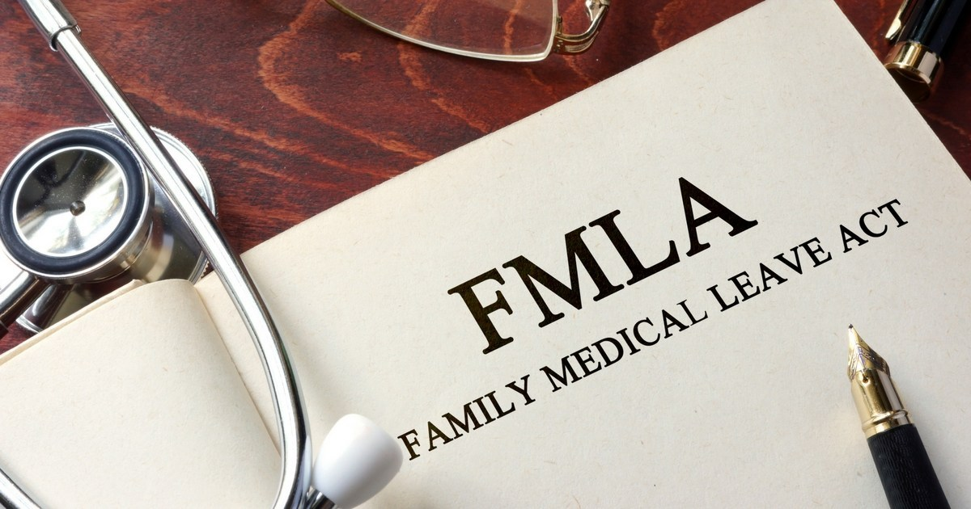
Building your toolkit
Checklists
  Reporting
    Worker’s Compensation
    FMLA

Slide 62

Building your toolkit
Checklists
  Reporting
    Worker’s Compensation
      Three Steps
      Seek Medical Treatment
      Report the Injury Immediately
      Complete Forms
https://documents.kenyon.edu/humanresources/report_workrelatedinjury.pdf

Slide 63
Building your toolkit
Checklists
  Reporting
    Worker’s Compensation
    FMLA
      Who is Eligible?
https://www.kenyon.edu/directories/offices-services/human-resources/employee-handbooks/administration-and-staff-handbook/unpaid-leaves-of-absence/

Slide 64
Building your toolkit
Checklists
  Reporting
    Worker’s Compensation
    FMLA
      Who is Eligible?
  Eligible employees (actively employed by Kenyon for a total of 12 months and have performed at least 1,250 hours of service during the twelve month period) may be entitled to job-protected family or medical leaves of absence (unpaid) if they are unable to come to work due to pressing family or medical concerns.

Slide 65
Building your toolkit
Checklists
  Reporting
    Worker’s Compensation
    FMLA
      Who is Eligible?
  II. How do you File?
  Contact Leah Miller in HR
Notes:
If you have someone who needs to file for FMLA, call Leah. FMLA paperwork is issued from the HR office. We keep a file in a confidential folder for each employee who files FMLA. Tracking time is the responsibility between you, the supervisor, and the employee.

Slide 66
Tracking fmla
Kenyon policy requires that any paid time be used concurrently with FMLA
Example:
Cathy has to take 4 weeks off for foot surgery. She has ten days of vacation remaining and five SPF days. She must use five of her remaining vacation days and all of her remaining SPF days concurrently with her FMLA leave.
She can keep five days on reserve as per Kenyon policy.

Slide 67

Need more help?
https://www.kenyon.edu/directories/offices-services/human-resources/supervisors-toolkit/

Slide 68

Contact Information
Leah Miller
Eaton Center North
(740) 427-5771
Miller5@Kenyon.edu

